Slide 1
Scripting 3
Class 2 : Version Control

Slide 2
Structure
What is a Version control
What is it used for
Version control types
Version control Setup

Slide 3

What is a version control
A system that records changes to a file over time so you can recall specific versions later.

Slide 4
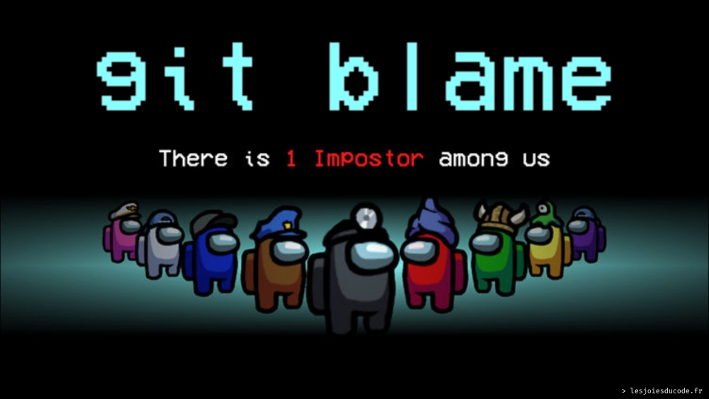
What is a version control
A way for centrally storing files
Keeping record of changes
Who did what and when
Covering yourself when things go wrong

Slide 5
Terminology
Concepts
Actions
VCS/SCM
Repo
Server/Client
Branch/Stream
Origin
Master/Main
Conflict
Clone
Pull
Commit
Push
Merge
Revert

Slide 6
Terminology : Concepts
VCS/SCM : Version Control System (abbreviated as VCS) or Source Code Manager (abbreviated as SCM), is a tool that manages different versions of source code.
Repo : Short for repository, is a directory that contains your project work and can exist either locally on your computer or as a remote copy on another computer. It contains and track all changes made within it
Client/Server: Server is where the repo is stored and client is the computer connecting to it

Slide 7
Terminology : Concepts
Origin : The central repo that lives on the server
Branch/Stream : A line of development that diverge from the main line of development
Master/Main : The core line used for development
Conflict : An issue related to updating same properties of a file by different people

Slide 8
Terminology : Actions
Clone : The action of cloning the repo on the server within your local machine
Pull : The action to update the project with the latest changes from the server
Commit : The action to place your changes under the version control
Push : The action to send your modification to the server
Merge : The action to merge different changes/branches to become one
Revert : The action to undo changes that were pushed to the server

Slide 9
Why using Version control
Individual
Team
Backup solution
Change history
Branching
Working on the same code base
Merge changes across same files
Answer who did what

Slide 10
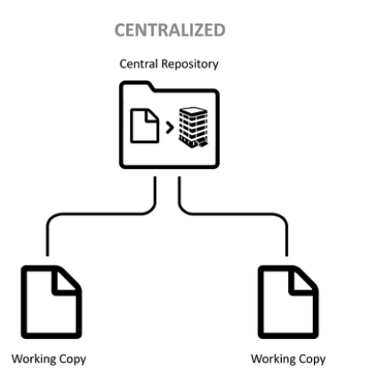
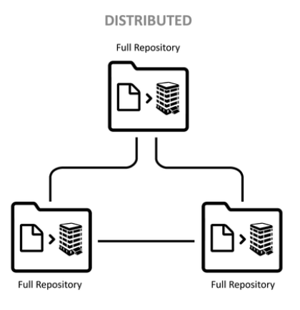
Version control types

Slide 11
Let’s get to work

Slide 12
Project setup
Create a repo on github.com
Don't forget to add the .gitignore file
Clone the repo to an empty folder through your favorite software
Create a Unity project in a different folder
Move the Unity project into the cloned repo
Commit and push the addition of the Unity files

Slide 13
Useful resources
https://girliemac.com/blog/2017/12/26/git-purr/
https://github.com/
https://www.sourcetreeapp.com/
https://www.gitkraken.com/

